Slide 1

Kaggle LLM Science Exam
Riyaj Muhammad

Slide 2
Competition
The competition is based on Multiple QA task in field of STEM.
The dataset consist of question and 5 options. One of the answer is correct.
There are two ways to solve this problem.
First is to use SOTA LLMs directly with question and answers. Now the platform has some hardware constraints. Which limits the options we can run as larger LLMS are time consuming and hardware extensive. Quantization reduces quality.
LLMs also has Hallucination problem that becomes a headache.

Slide 3
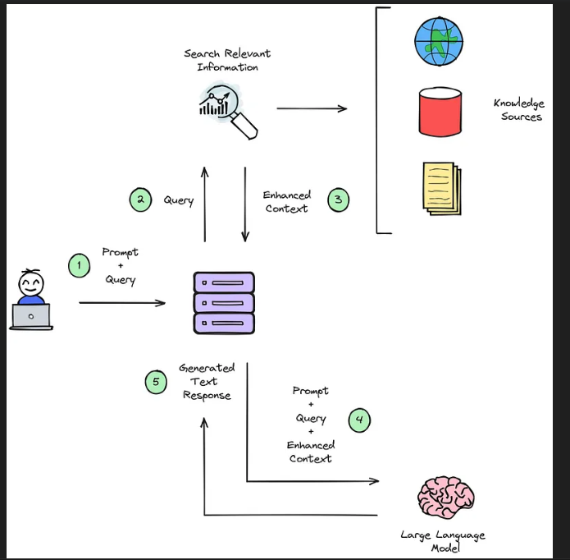
Competition
Another option is to use RAG which eliminate hallucinationproblem all together.

Slide 4
RAG
RAG is known as Retrieval augmented generation.
We have used a large knowledge base consist of 270K wiki articles on STEM.
These article then classified into paragraphs.
Now a based on the cosine similarity of the question with these paragraph most related paragraphs a re being used as a context which then fed into model alongside question and answer to get the correct answers.

Slide 5
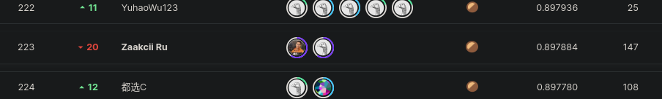
Conclusion
We used Deberta v3 instead of LLMs. Which is speedy in inference and have higher accuracy.
We had frozen 16 layers of 24 layers model. And trained it with CosineAnnealingLR with Warm-up 1 epoch is enough to give us the 223rd rand out of 2660 competitors.

